Slide 1
Marketplace App
Renee Nilsen

Slide 2
Background
MAJOR BOARDGAME GEEK!
Collect figurines of my favourite series, movies, animation
Huge cash blackhole

Slide 3
Geeky Exchange
Geeky Exchange was created to build one place where shop owners and general public can sell their various geeky/pop culture items such as figurines, comics and board games.
This allows customers to go to one site and have a single check out rather then looking through many websites and having many transactions.
Customers can find and buy what they are looking for and sell what they no longer want.

Slide 4
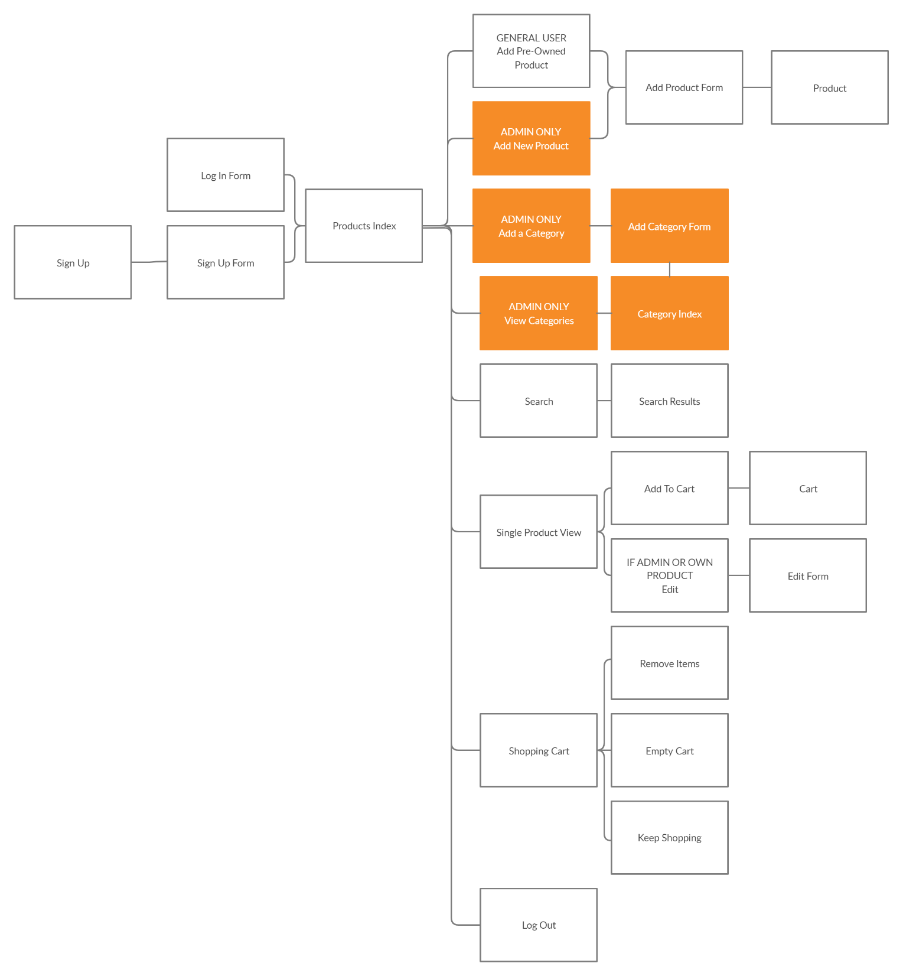

Slide 5
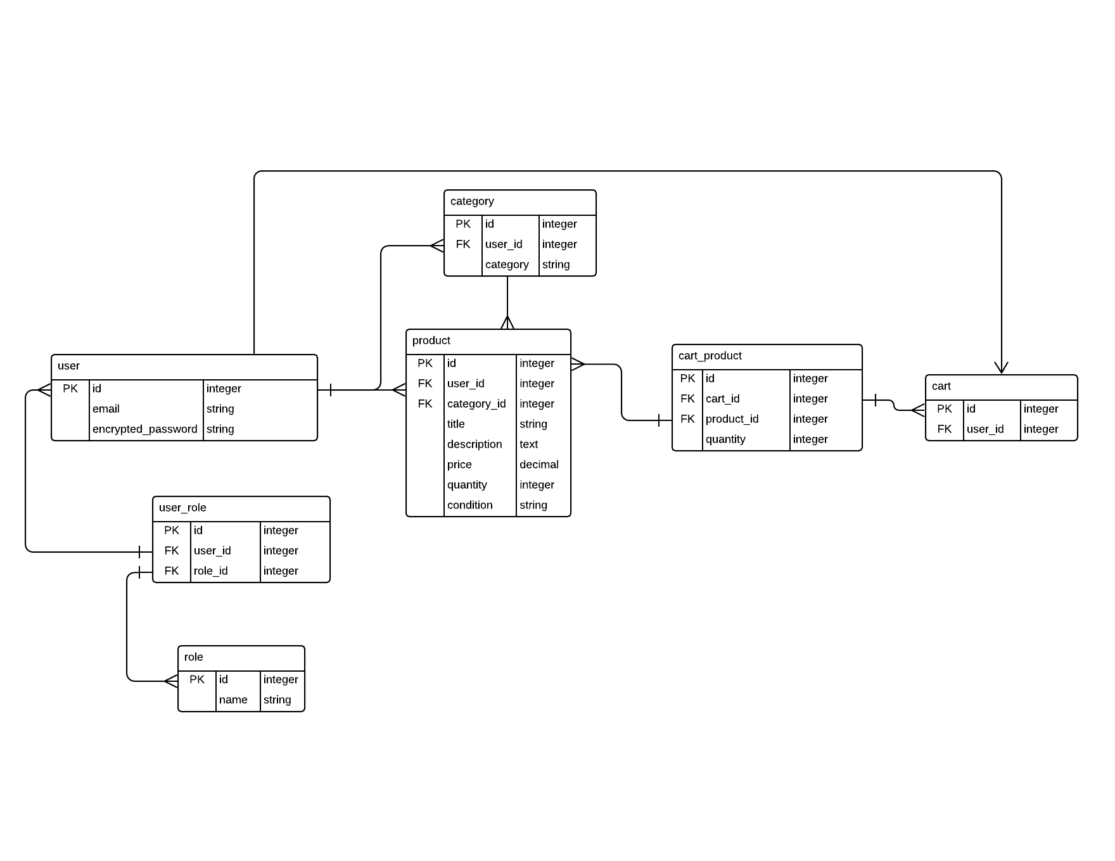

Slide 6
